Slide 1
Socratic Discussion
A Model for Civil Discourse and Discussion

Slide 2
Learning Targets
  I can explain how Socratic discussion is different from an open classroom discussion or a discussion with my friends (e.g., “civil discourse”).
  I can explain the responsibilities of both the inner circle and the outer circle.
  I can explain what I need to do to prepare for
  the Socratic Seminar next week.

Slide 3
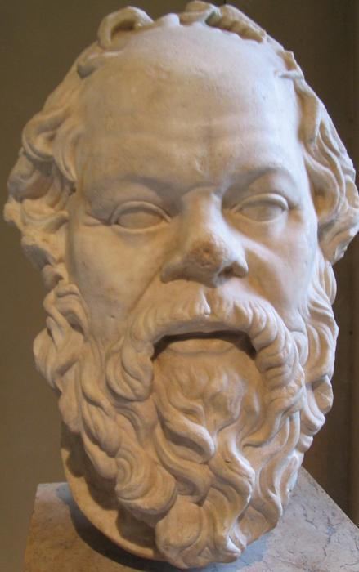
Who was Socrates?
Known as a Greek Philosopher who lived 469-399 BC
Cited as one of the world’s most famous teachers
Used discussion/discourse for instruction
Was sentenced to death for his role in propagating rebellion of youth against traditional wisdom. Instead of being killed at the hands of the state, Socrates reportedly drank hemlock and died.
Established a method of civil discourse/discussion that is at the foundation of debate, U.S. courtroom/legal proceedings, and commonly accepted meeting formats, such as Roberts Rules for Order.

Slide 4
The Roots of Socratic Discussion
Named for the embodiment of Socrates’ belief in the power of:
asking questions
using inquiry over delivery of information
using discussion over debate
In Socratic seminar, the goal is to encourage thinking, not to come to conclusions or change someone else’s mind

Slide 5
Educational Theory
The Socratic seminar is a formal discussion, based on a text, in which the leader asks open-ended questions. Within the context of the discussion, students listen closely to the comments of others, think critically for themselves, and articulate their own thoughts and their responses to the thoughts of others. They learn to work cooperatively and to question intelligently and civilly. (89)
Israel, Elfie. “Examining Multiple Perspectives in Literature.” In Inquiry and the Literary Text: Constructing Discussions in the English Classroom. James Holden and John S. Schmit, eds. Urbana, IL: NCTE, 2002.

Slide 6
Assessment (see rubric)
You will be assessed through the following
Preparedness: Did you take notes? Were you prepared with questions and direct quotes from the text?
Participation: Did you ask questions? Make connections? Use textual evidence? Build on ideas?
Feedback (coaching) and reflection: Did you provide helpful feedback to your partner? Did you set goals and record your progress toward them?

Slide 7
How Does It Work?
The class is divided into two groups:
The Inner Circle and The Outer Circle
Roles and Responsibilities
Group one is seated in an inside circle. This is the group who will be responding first to the discussion questions.
Group two sits outside the circle taking notes over
the overall discussion and their partner’s individual progress toward meeting goals.

Slide 8

Inner Circle-1st Round Discussers
Seating Arrangement

Slide 9
Roles and Responsibilities
  Each member of the inner circle is expected to participate. Points will be recorded for participation and quality of participation.
  The coach for each student record responses and shares them with his/her partner during half time and after the seminar. Points are tallied by the teacher.

Slide 10
The Inner Circle
Come to the discussion prepared by having read and taken notes over the assigned texts.
  (NOTE: Both groups will at one point be in the inner circle, so both groups should read, take notes and write questions.)
  Questions should encourage deeper thinking and new ideas
  Notes should include direct, relevant quotes from the text to be used in seminar to support ideas

Slide 11
The Inner Circle, continued
Consider, while reading the text, what kinds of questions might be important to this text.
  What if. . .
  How is this story/information similar or different. . .?
  How important is this information. . .
  To what experiences in my life can I relate this story/info?

Slide 12
The Inner Circle
When questions are raised for the inner circle, students will raise hands and be acknowledged before speaking.
When one member is speaking, all other members of both the inside circle and the outside circle are expected to listen with respect.
  This means not talking, not raising a hand while another is speaking, and not engaging in any distracting behavior.
  To do so is an inherent nonverbal message of disrespect to the speaker.

Slide 13
The Inner Circle, cont’d
Respect the opinions of others.
  Listen when others are speaking.
  Make comments that will advance the discussion.
    Connect back to the text.
    Connect back to what others have said (agree, disagree, add to).
    Share an opinion (text to self, text to world).

Slide 14
Connecting/Transitioning Methods
How to connect to previous speakers:
I want to build on. . .
I want to connect my thoughts to. . .
I agree/disagree with. . . because
I have a question about what Cameron said earlier; “Cameron, you said. . .”. Did you mean. . .?
I’ve changed my mind about ____ based on what ____ or what was stated in the text.
Based on the time this was written. . .
I think the speaker was trying to say. . . (or) Emily said. . . I think/wonder if she meant. . .

Slide 15
The Outside Circle
Hot Seat
Listeners/Recorders

Slide 16
The Outer Circle
Outer Circle members’ primary responsibility is to listen, take notes, and record partner responses
  When your partner speaks, a tally mark needs to be placed on the rubric
  When your partner is NOT speaking, other notes need to be completed
  During half time, all the information will be shared with your partner to help them improve for the second half of the seminar, focusing on the partner’s goals
  The outer circle will hold to the same standards of respect as the outer circle

Slide 17
  Other Roles
  Transition Tracker
  Quote Tracker
  Tally Keeper (who is speaking and how many times)
  “Big Idea” tracker
  Each of these roles will “share out” findings and offer suggestions during half time

Slide 18
Final Thoughts
Socratic Discussion is based upon the belief that students are capable of thinking critically without being “fed” questions and “cued” answers by the teacher.
  Mastery of Socratic Discussion techniques will contribute to success in college and careers and in effective collaboration. This type of discourse is not about “winning”. It is about advancing learning through respectful discourse, the civil exchange of ideas.
  By listening to others, we all grow.
While participating in Socratic Discussion, pay attention to the types of questions that further a discussion and those that stifle discussion. Understanding such questioning techniques will pay off in social situations, in job interviews, in business networking. It’s a great life skill.

Slide 19
Respond on Your Paper to the Following:
  How is Socratic discussion different from an open classroom discussion or a discussion with my friends (e.g., “civil discourse”).
  Explain what the responsibilities of the members of both the inner circle and the outer circle are.
  Explain what you need to do tonight in order to prepare for our Socratic discussion tomorrow.

