Slide 1
Narrative Structure
Using Arcs to Analyze Author’s Purpose in Literature

Slide 2
Learning Target
I can identify how writers engage readers through their purposeful development of narrative structure.
I can analyze a text using the arc structures and share my findings with a group in a meaningful way, tying my arguments back to textual evidence.

Slide 3
Narrative
Writing where the author’s aim (purpose) is to make a point by sharing a story about an event

Slide 4
Narrative Arc
The chronological construction of plot in a story
Typically looks like a pyramid, made up of exposition, rising action, climax, falling action, and resolution
Three types of arc: physical, emotional, and intentional

Slide 5
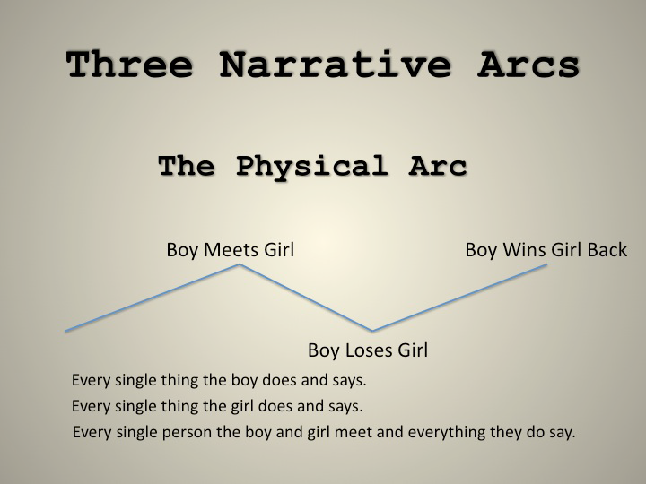
Physical (Narrative) Arc
Every single thing that happens in a story
Often referred to as the plot

Slide 6
Pacing
Manipulation of time
  Chronological order – arrangement of details in order of their occurrence
  Flashback – section of literary work that presents an event or series of events that occurred earlier than the current time in the work
  Foreshadowing – presenting materials that hint at events to occur later in a story

Slide 7
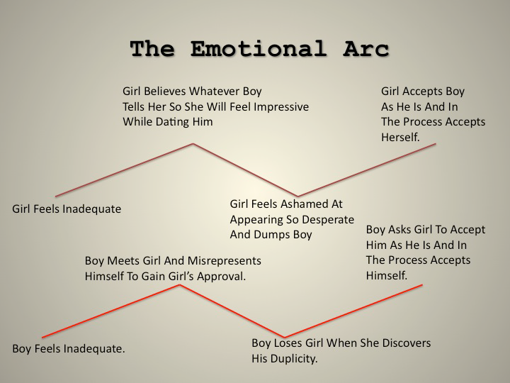
Emotional Arc
The trace of each character’s emotional progress
As characters move or do not move through their beliefs, their feelings and motivations change.

Slide 8
Character
Person who figures in the action of a literary work
  Protagonist – main character
  Antagonist – pitted against main character
  Flat character – exhibits a single dominant quality
  Rounded character – exhibits the complexity of traits associated with actual human beings
  Static character – does not change during the course of the action
  Dynamic character – does change
  Stock character – found again and again in literature

Slide 9
Reader Response Arc
The trace of the reader’s response to the events, characters, and emotional appeal of the text
Although this is individual, a good writer will have calculated how the reader will feel in response to the text
The highest points are the points of strongest emotional response

Slide 10
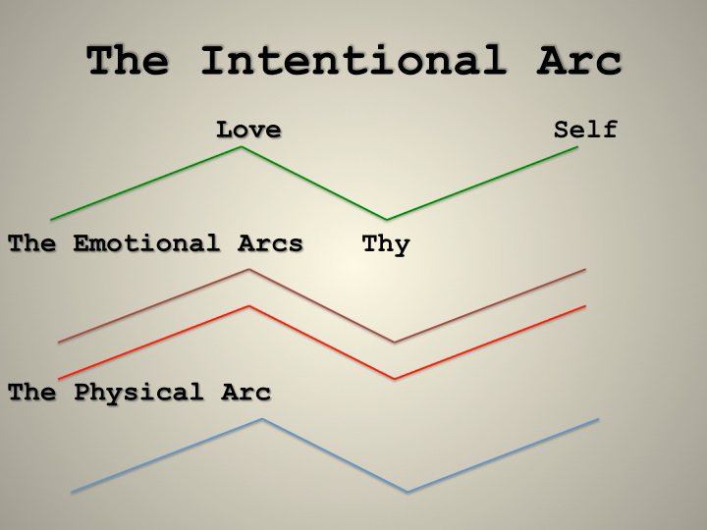
Intentional Arc
Why the author tells the story
It is the theme, the metaphor, the message.
The highest point will often be at the end when the author’s motives have most been revealed

Slide 11
Abstraction
Reflecting upon a story and considering the theme/moral/message, apart from concrete realities, specific objects, or actual instances

Slide 12
Theme
A central idea in a literacy work
Topic + Opinion
“Topic” is usually an abstraction
“Opinion” is what an author wants to say about the topic- his or her opinion on it

Slide 13
Theme Examples
Ex: Topic (Creativity) + Opinion (can be alienating when an idea is before its time)
Theme statement: Creativity can be alienating when an idea is before its time.
Ex: Topic (Love) + Opinion (is the most painful but most worthwhile emotion)
Theme statement: Love is the most painful but most worthwhile emotion.

Slide 14
Your Assignment: begin at the end with the intentional arc
“My sweet blue-eyed girl,” he said in a half-sung sigh that had nothing to do with her brown eyes but was taken up just the same by the vast sunlit reaches of the land behind him on all sides of him- so much land that Connie had never seen before and did not recognize except to know she was going to it.

Slide 15
Map the Intentional Arc
What does the end mean? What is the author trying to say? Write this as a theme statement at the end of your arc.
How did they get there? Trace and graph the events leading up to the end.

Slide 16
Map a Second Arc
Over the intentional arc, map a second arc which you will have been assigned:
    Physical
    Emotional
    Reader Response

Slide 17
Present
Your graphs and explanations of the two arcs
Describe the points of intersection:
  How did the graphs interact with one another (if you are like me, this will not be literal ☺)

